Slide 1

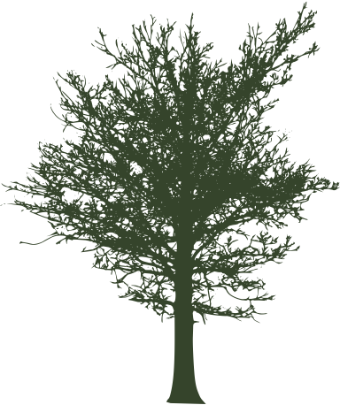
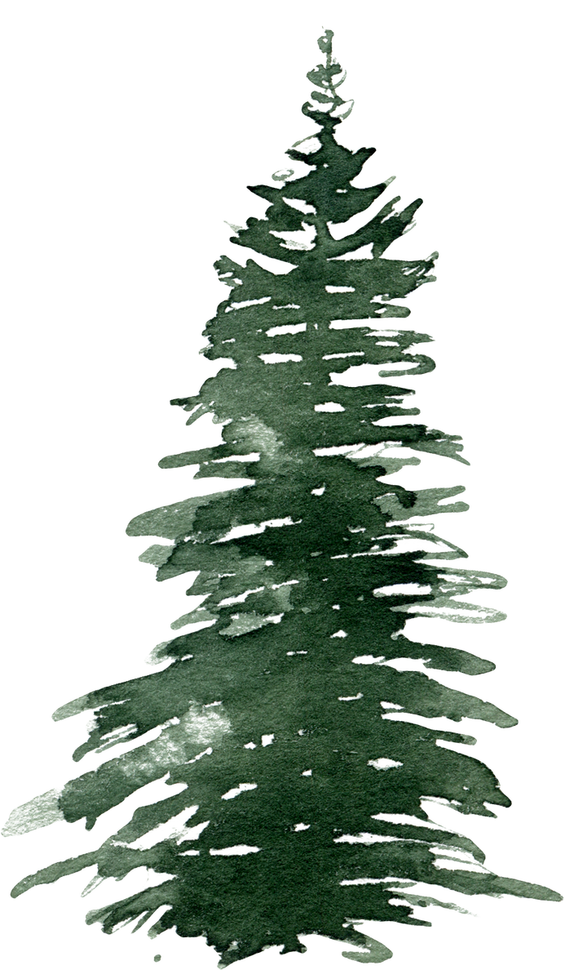
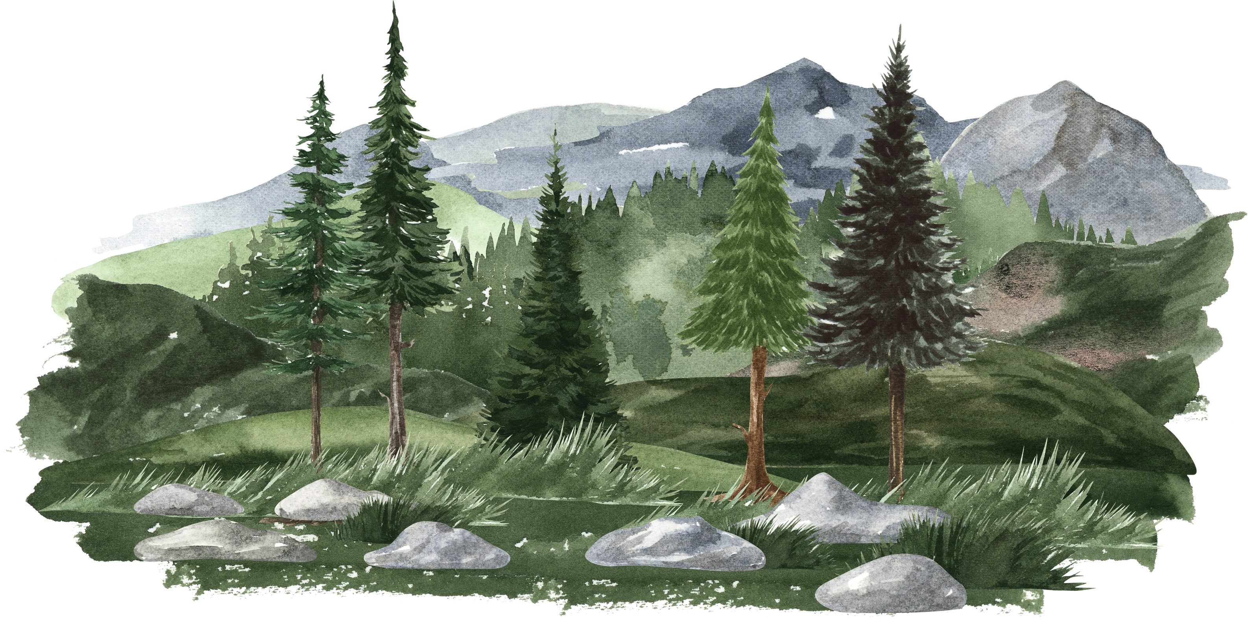
Indigenous Societies
Pre-Contact

Slide 2
Indigenous Societies
Mi’kmaq
Haudenosaunee
Anishinabe

Slide 3
Mi’kmaq
  Their territory was most of the East Coast: Nova Scotia, New Brunswick, and PEI.
  Hunters, gatherers, and fishers.
  They sheltered in wigwams, similar to tipis but made of wood and bark so that they could access shorelines in warmer summers and find shelter in the forest during the harsh winters.
  They believed Kisúlk, the Creator, made humans equal to the all things in nature -which they called Mother Earth- so there was unity and respect for all.
  Organized into clans for respect of fishing territories and sharing of resources. The leaders of these clans were called sagamaw and were chosen on merit.
  There were 7 districts, each with a leader and a council. The leader’s job was to reach agreements among the people: decision making by consensus.
  The role of women was to ensure access to all resources necessary to live a good life, raised children, and cared for the homestead but also hunted small game.
  Women took the primary role as Elders for consultation on any and all questions such as whether or not to go to war.
  They were the first contact for explorers John Cabot.

Slide 4
Haudenosaunee
  Their territory was the woodlands of North and South of the St. Lawrence River.
  The fertile soil and mild climate made it ideal for them to become farmers.
  Their territory was the woodlands of North and South of the St. Lawrence River.
  The fertile soil and mild climate made it ideal for them to become farmers.
  Also known as (aka): Iroquois Confederacy. Comprised of six First Nations.
  Shared language: Algonquin. Dwellings: permanent long houses. That is where Haudenosaunee get their name “people of the long house”.
  The Three Sisters referenced corn, beans, and squash which grew harmoniously and corn suported the climbing bean stocks, the squash leaves discouraged weeds and provided shade to keep moisture in the soil.
  Women tended to the crops and ensured equitable resource sharing to children, then Elders, then women, and finally the men. Society was matrilineal. This means each long house had a Clan Mother, and all possessions belonged to the women.
  Women were well respected for their ability to create life, just like Mother Earth. Women played pivotal roles in ceremonies and decisions like whether to go to war.
  They were very conscious of taking care of Mother Earth and ensuring a good life for future generations. Continued...

Slide 5
Haudenosaunee
  Alliances were common among First Nations but one that stands out above the rest is the Iroquois Confederacy.
  Long before Europeans arrived, oral history tells us that the five nations of the Mohawk, Oneida [oh-NY-duh], Onondaga [on-on-DOG-uh], Cayuga [kay-OO-guh], and Seneca [SEN-uh-kuh] were at war with one another. A peacemaker arrived in a stone canoe with a message of peace to unite them all as the Iroquois Confederacy.
  In 1715, the Tuscarora [TUS-kuh-ror-ruh] joined to form the Six Nations Confederacy.
  Women (the Clan Mothers) chose the male leaders and could take that status away.
  The six nations sent leaders (50 total) to the central council at least once a year to discuss treaties, trade, and disputes. This took place around a fire until consensus was reached.
  Samuel de Champlain was a permanent enemy of the Iroquois (Mohawk) near what’s now Lake Champlain after 1609. Using firearms for the first time in Indigenous warfare, he helped defeat the Iroquois war party.
  The Iroquois, in turn, eventually allied themselves with the British, especially as fur trade competition and colonial wars grew in the 1600s–1700s.

Slide 6
Anishinabe
  Lived in birchbark lodges, in the wooded country of northern and central Ontario and southern Manitoba. They eventually moved westward on the Plains
  Europeans called them “Ojibway” or “Saulteaux”. Anishinabe means “the people”.
  They were hunter-gatherers but had a unique food source: wild rice.
  Men and women were seen as equal, with specific jobs for the good of the community. Women worked at maintaining the lodge and children but also hunted small animals when they weren’t harvesting fruits, berries, nuts, and roots. They dried these to store food for the winter so their community could survive. Only the women were allowed to partake in the harvest.
  Each family would lay claim to a portion of the harvest and mark maple trees for sap.
  The harvest was communal, meaning that it was a community effort. Like the Haudenosaunee, they held strong to traditional ways of harvesting so that the rice stocks would bear harvest again for future generations.
  They organized themselves into clans with duties that applied to the entire nation. Clan leaders were chosen on merit like the Mi’kmaq.

